Slide 1
Team Delphi -
Progress Update
Anirban Chowdhury, April Wang, Bhoomika Moorjani,
Manna Zhao, Rosa Jin

Slide 2
Data Source and Signals Exploration
Test positivity rate from CTIS and Quidel
Estimated test positivity rate (percent) among people tested for COVID-19 in the past 14 days (CTIS)
Percentage of antigen tests that were positive for COVID-19 (all ages), smoothed by pooling together the last 7 days of tests (Quidel)
Percentage of positive NAAT in the past 7 days ( Community Profile Report)
COVID symptoms (sore throat) from CTIS and Google search
Estimated % of people reporting that they or someone in their household experienced a sore throat in the past 24 hours (CTIS)
Measures search volume for “sore throat” symptom (Google search)
Early Indicators on COVID related doctor visits from Change HealthCare and claims
Notes:
COVID-19 Trends and Impact Survey (CTIS) run by the Delphi group at Carnegie Mellon. Facebook directs a random sample of its users to these surveys, which are voluntary. Users age 18 or older are eligible to complete the surveys, and their survey responses are held by CMU and are sharable with other health researchers under a data use agreement. No individual survey responses are shared back to Facebook.

Slide 3
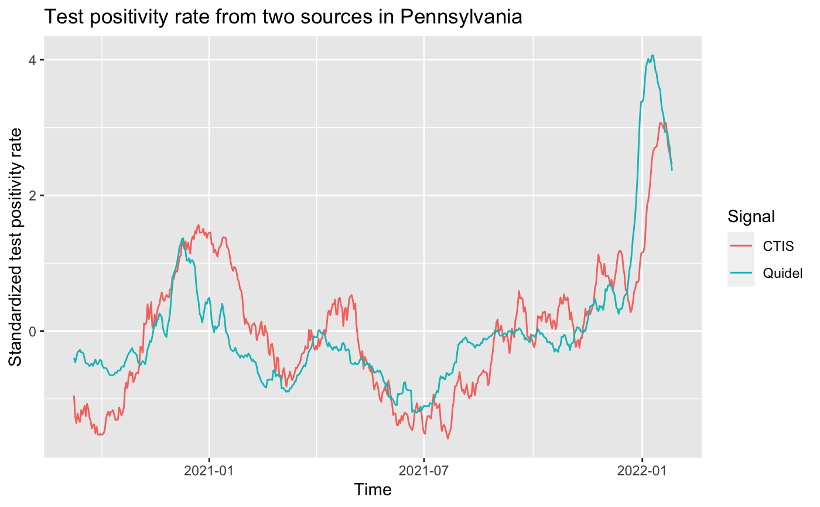
Test Positivity Rate
Rapid Antigen tests (at a doctor’s office, clinic, or hospital)
Spearman’s rank correlation rho estimate: 0.806
Notes:
Data source based on COVID-19 Antigen tests, provided to us by Quidel, Inc. When a patient (whether at a doctor’s office, clinic, or hospital) has COVID-like symptoms, doctors may order an antigen test. An antigen test can detect parts of the virus that are present during an active infection. This is in contrast with antibody tests, which detect parts of the immune system that react to the virus, but which persist long after the infection has passed.

Slide 4
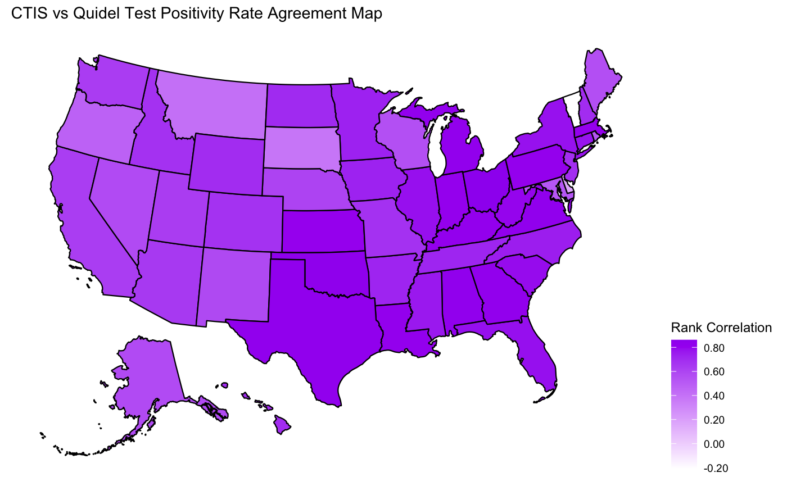
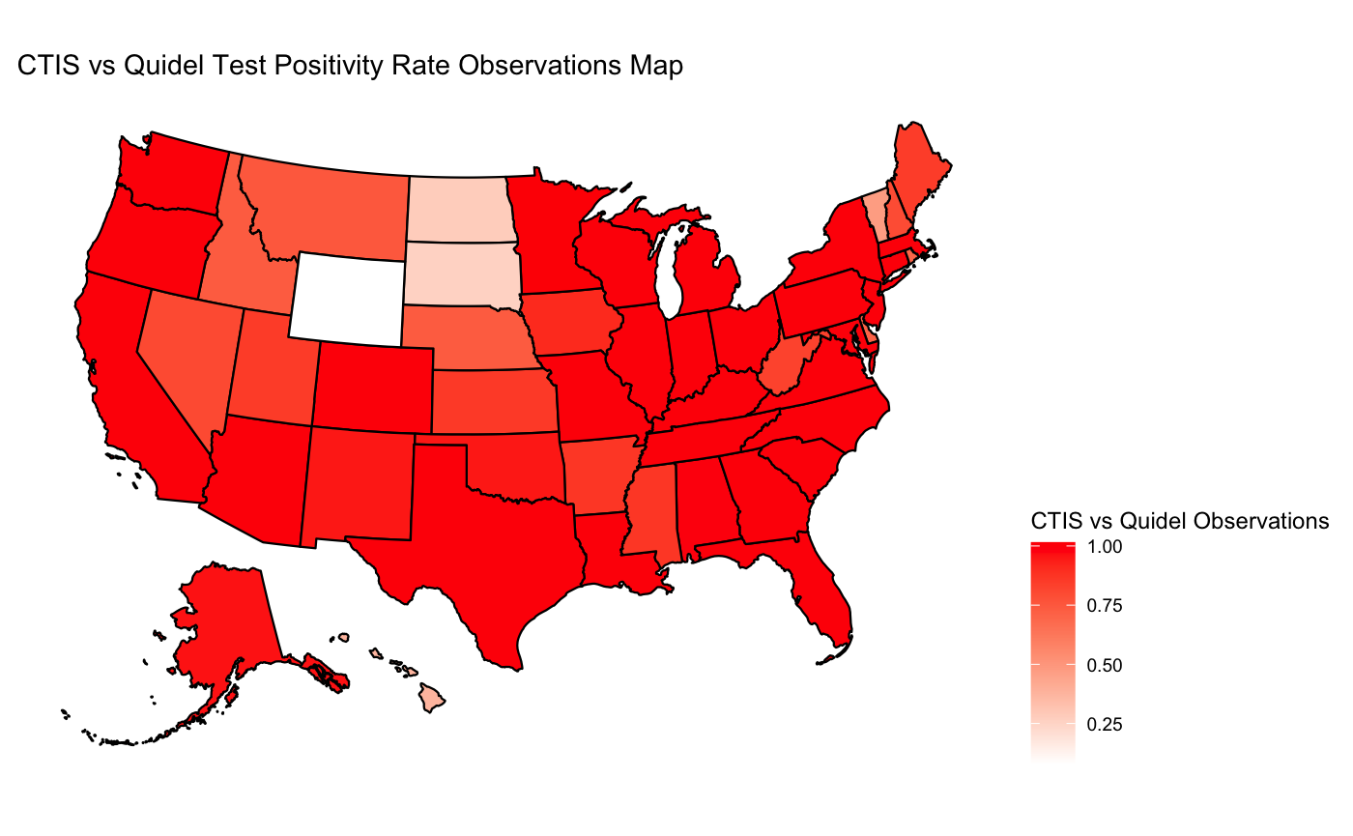
Test Positivity Rate - CTIS vs Quidel

Slide 5
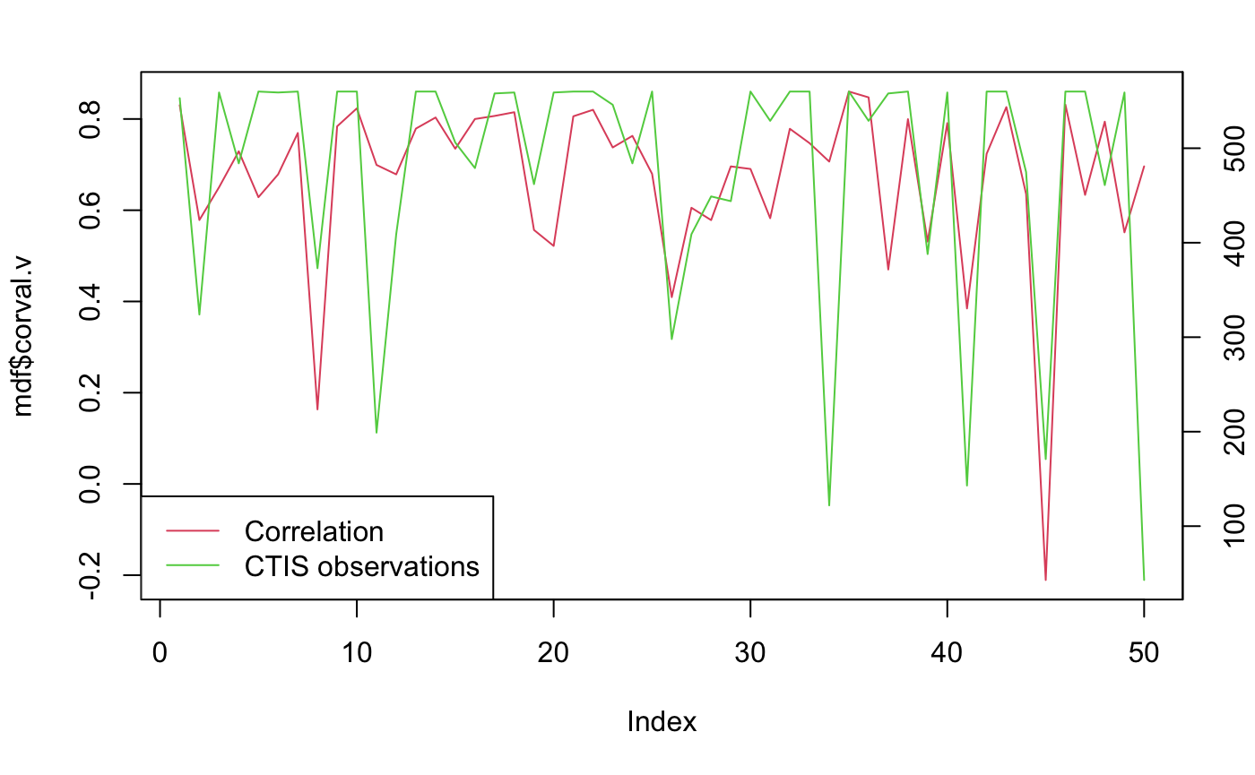
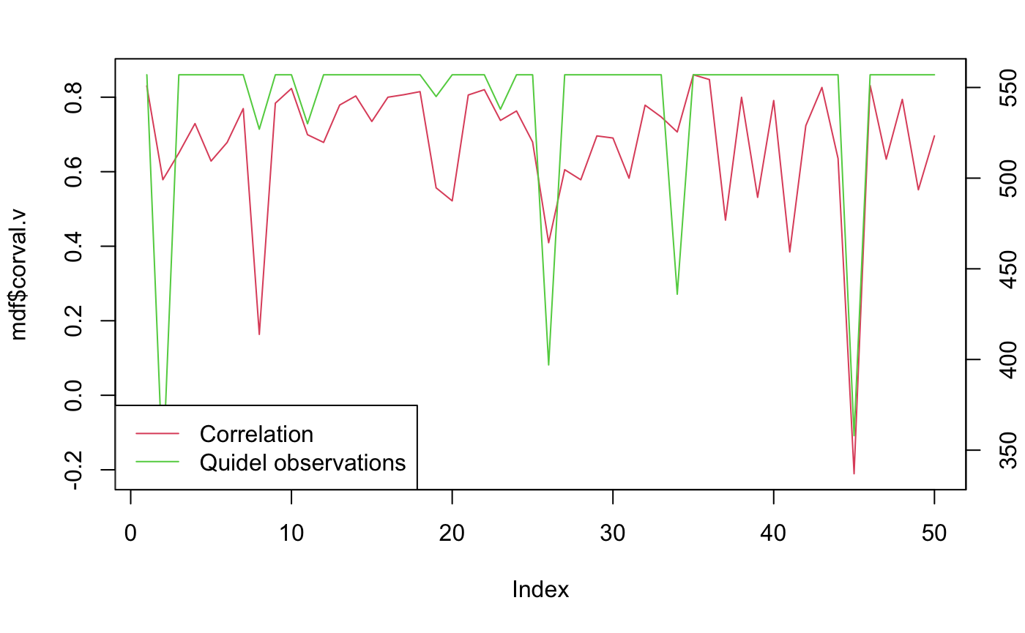
Test Positivity Rate - CTIS vs Quidel
Notes:
Instead of two axis

Slide 6
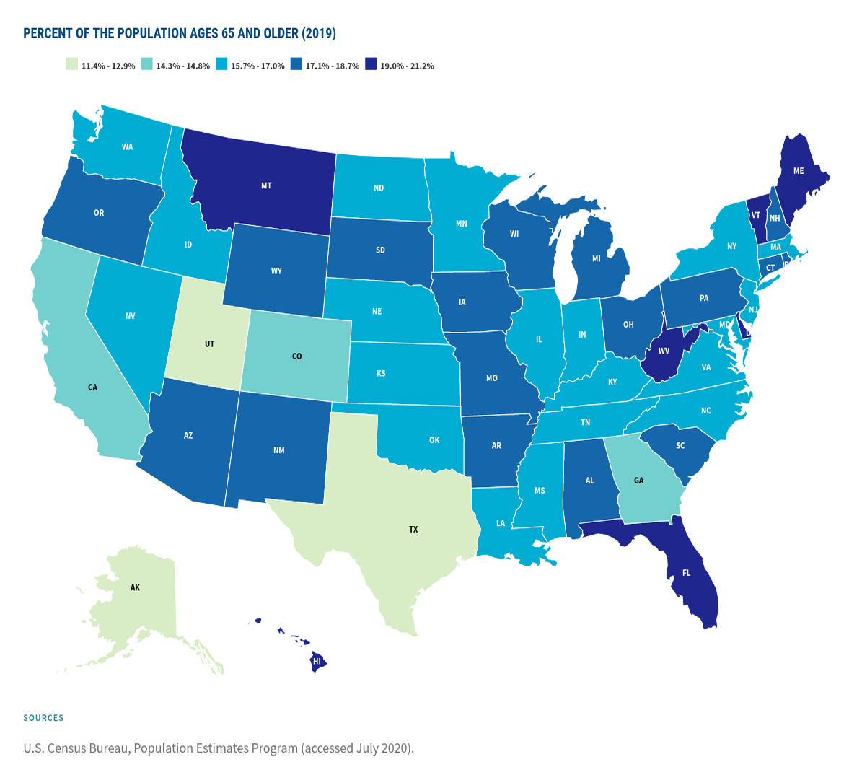
Test Positivity Rate - CTIS vs Quidel

Slide 7
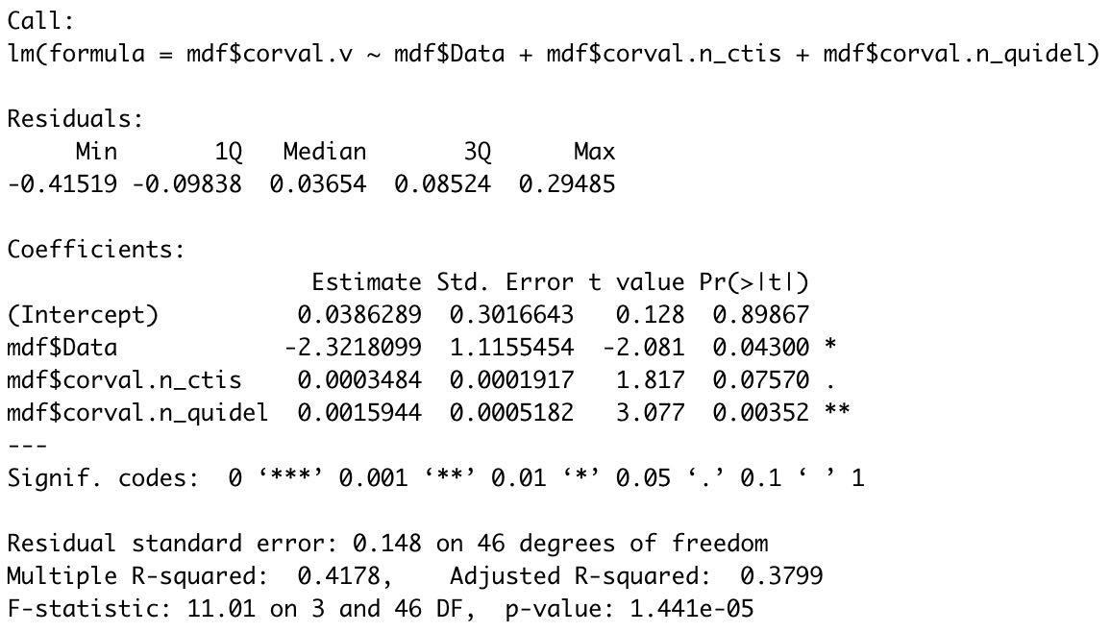
Test Positivity Rate - CTIS vs Quidel
Population aged 65 and above vs Rank correlation: -0.274
Notes:
1. Cor plot check before regression
2. Spearman instead of rank correlation
3. When does cor changes? When is low? When is high? For populous states

Slide 8
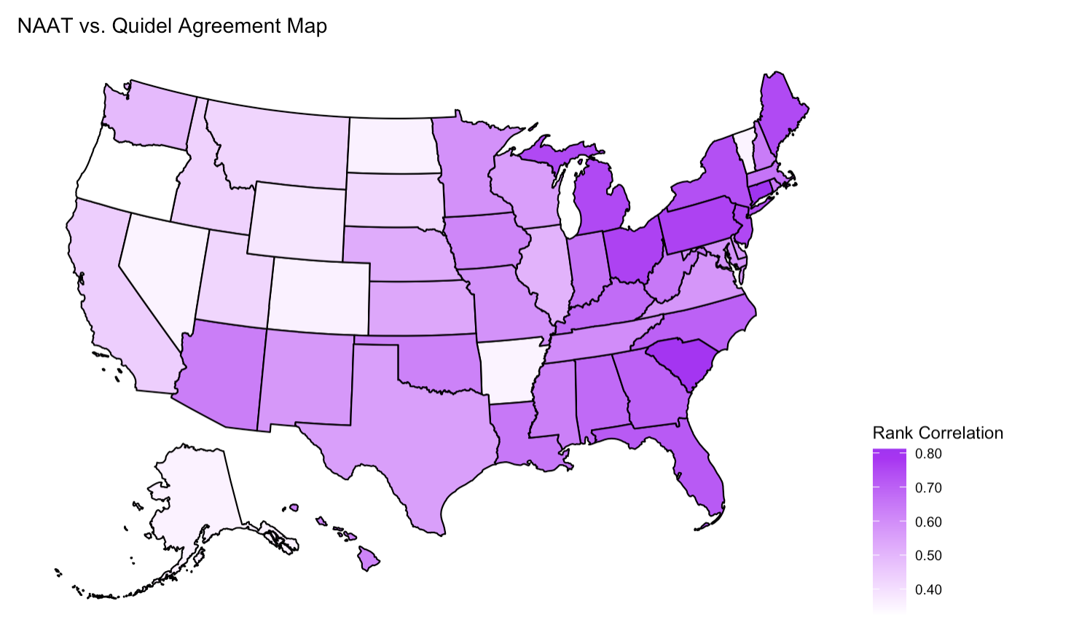
Test Positivity Rate - NAAT vs Quidel
State population vs. rank correlation:
0.4378
State population over 65 vs. rank correlation:
0.4558
State population over 65 (percent) vs. rank correlation:
0.3225

Slide 9
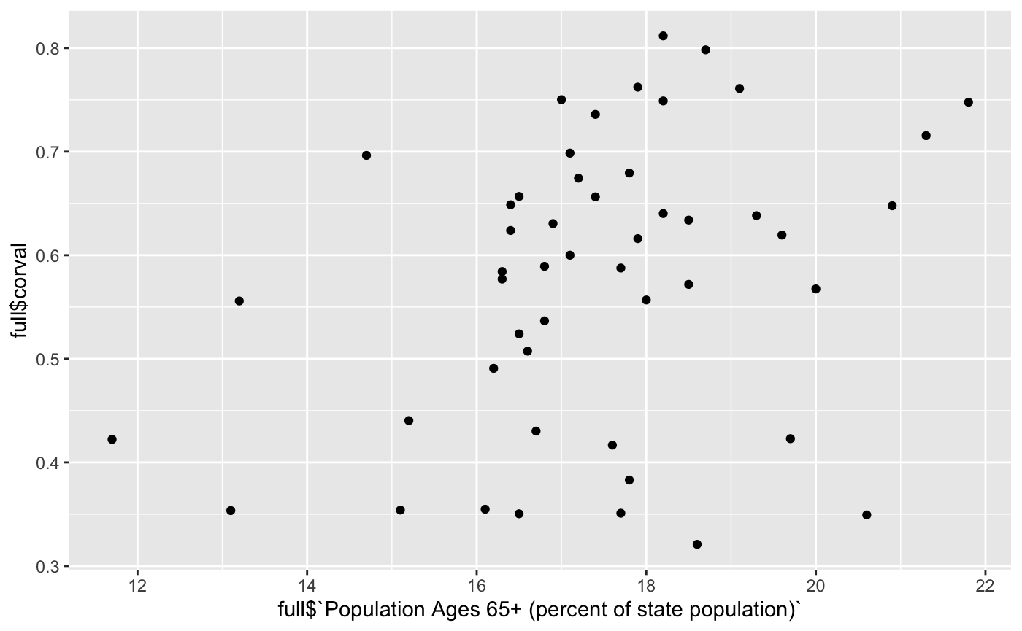

Slide 10
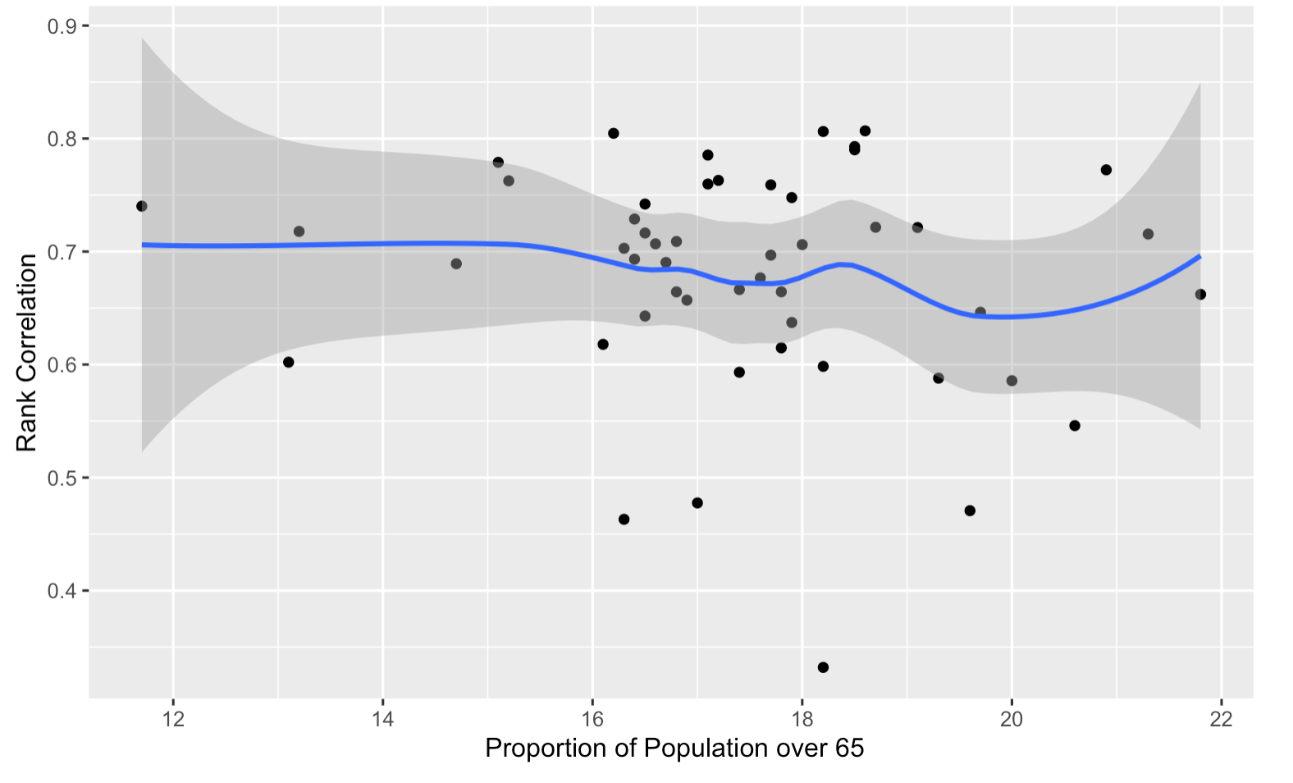
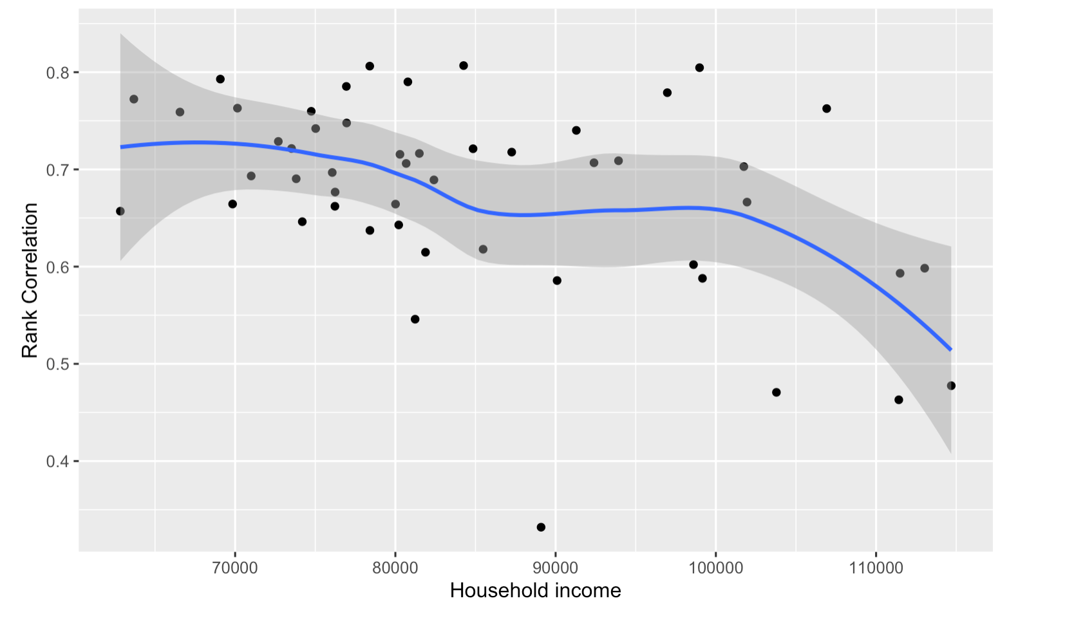
Investigating Disagreement in Google vs Facebook
Rank correlation vs. Demographic information

Slide 11
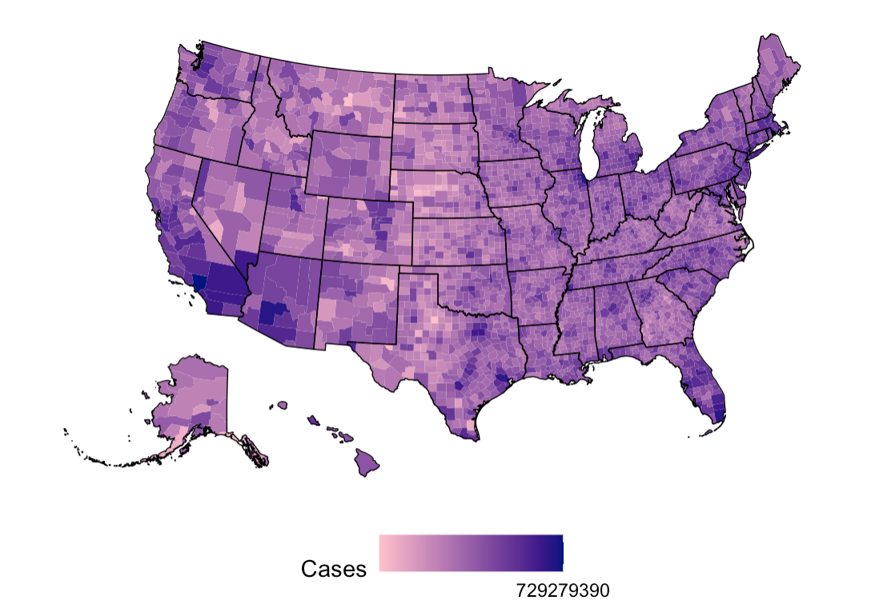
County-level Analysis on Covid Related Doc-Visits
County-level map for confirmed Covid cases
Choose counties that have deeper/lighter colors to look at doctor visits
Could fail because of county-merging

Slide 12
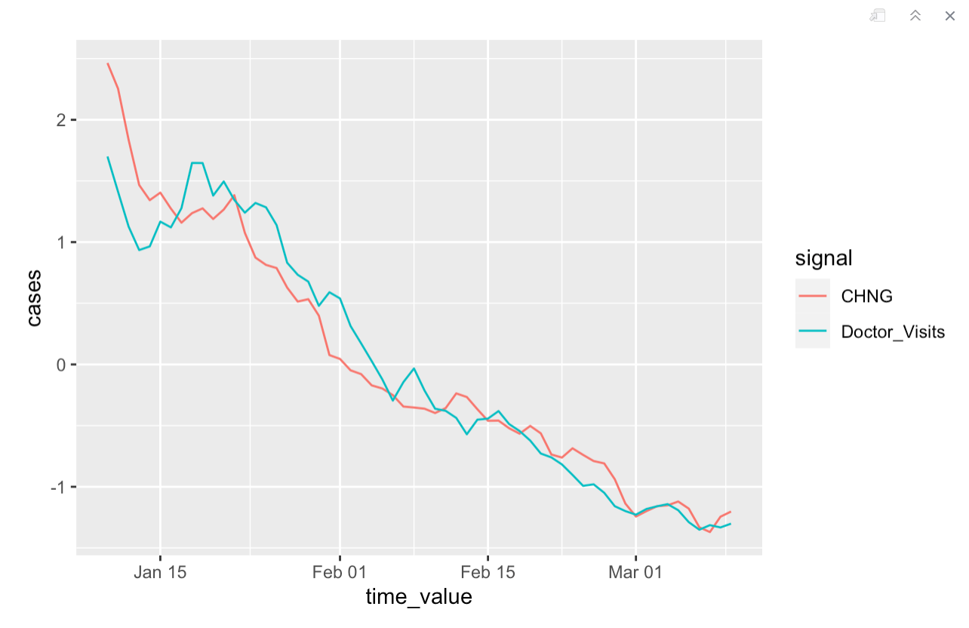
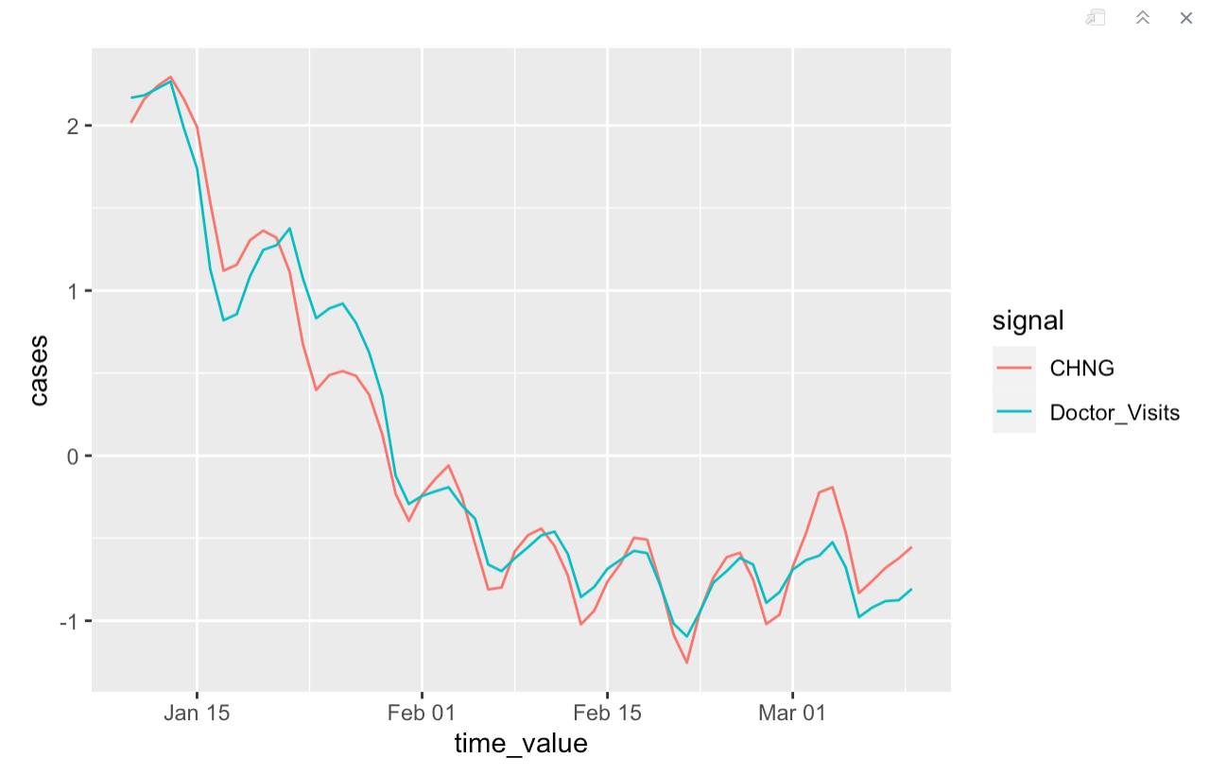
County-level Analysis on Covid Related Doc-visits
County 06037(Hartford County) as an example
Most recent data of these two months
The more recent the data is, the better agreement we have (generally going down)
Spearman correlation: 0.72354

Slide 13
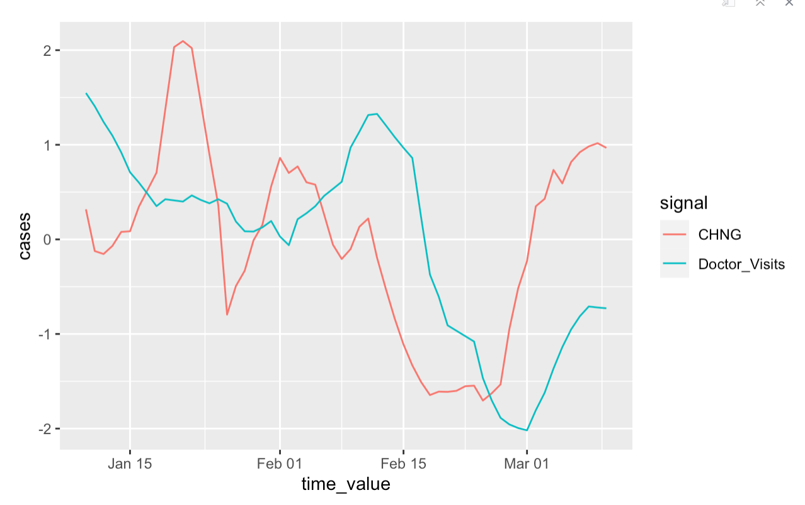
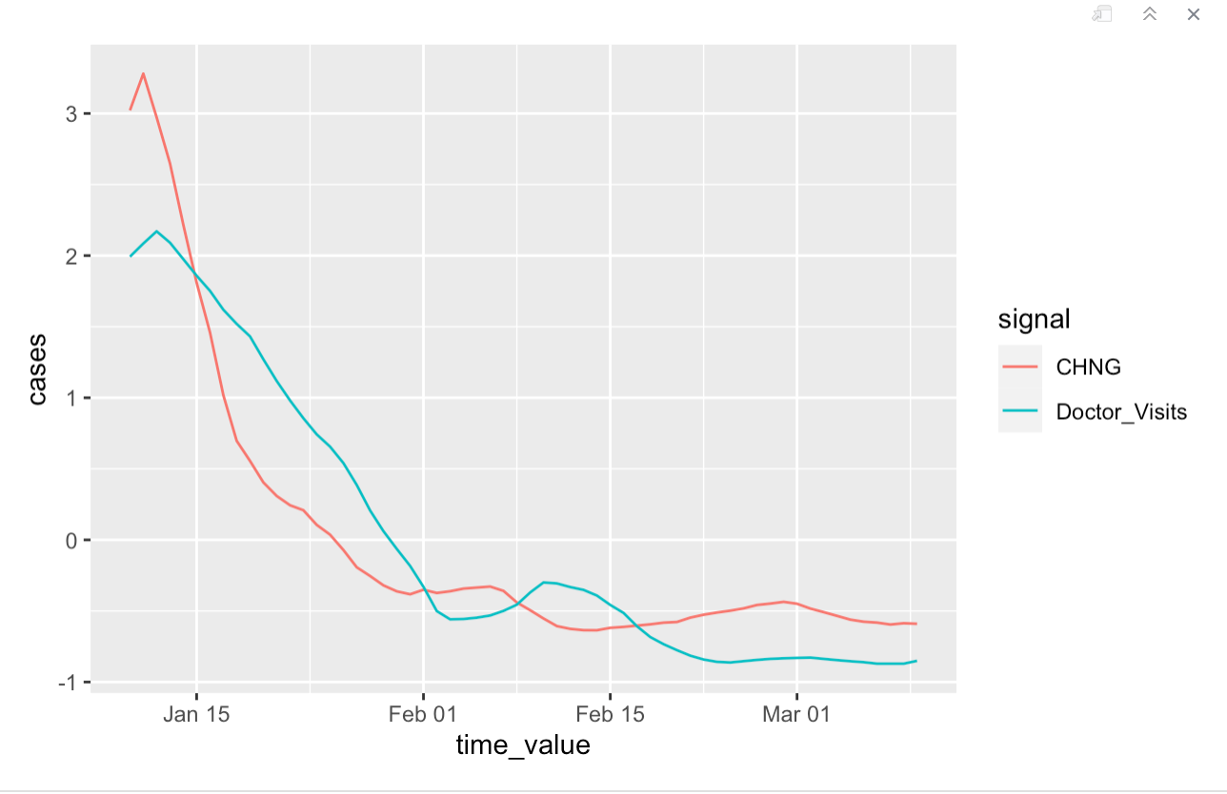
County-level Analysis on Covid Related Doc-visits
County 05217(Columbia County) as an example
2021/2022 1-3, agree more in recent times
Spearman correlation: 0.4356

Slide 14
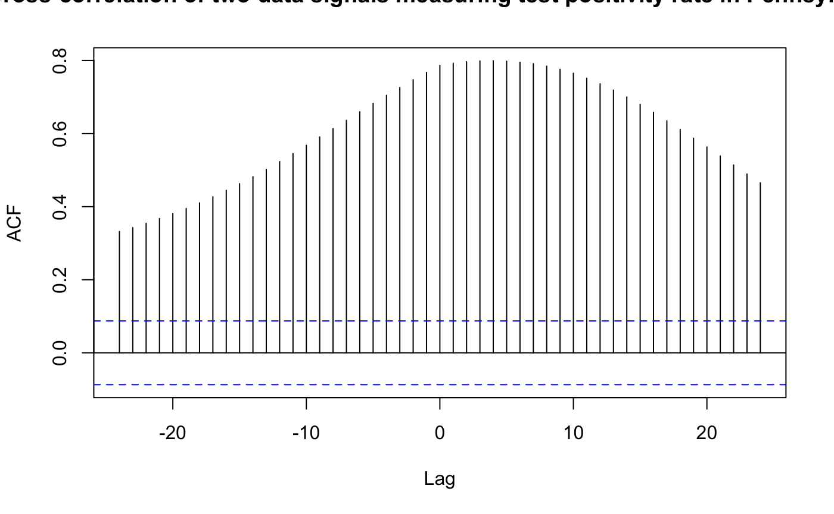
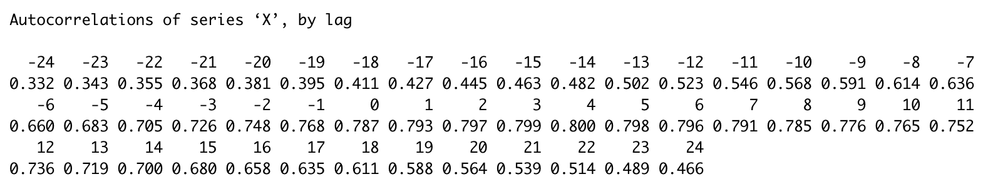
Test Positivity Rate - Overall Cross-correlation
Notes:
Poor agreement when rates are low or high?
What might happen at disagreement?

Slide 15
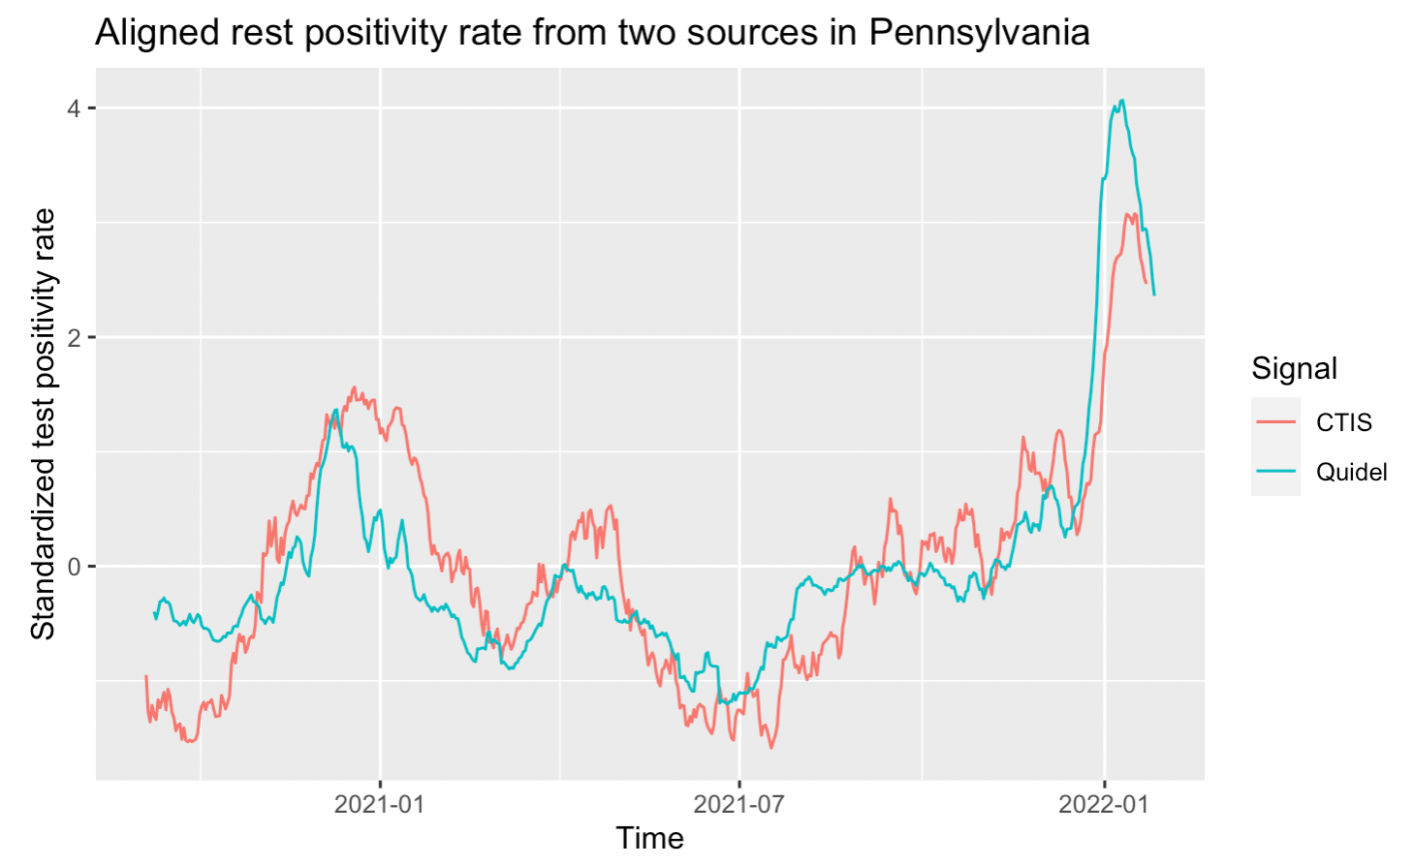
Test Positivity Rate - Overall Aligned
Aligned series based on highest CCF value
Lag 4 agreement
Very similar appearance - suggests we examine peaks individually for better alignment
Notes:
Data source based on COVID-19 Antigen tests, provided to us by Quidel, Inc. When a patient (whether at a doctor’s office, clinic, or hospital) has COVID-like symptoms, doctors may order an antigen test. An antigen test can detect parts of the virus that are present during an active infection. This is in contrast with antibody tests, which detect parts of the immune system that react to the virus, but which persist long after the infection has passed.

Slide 16
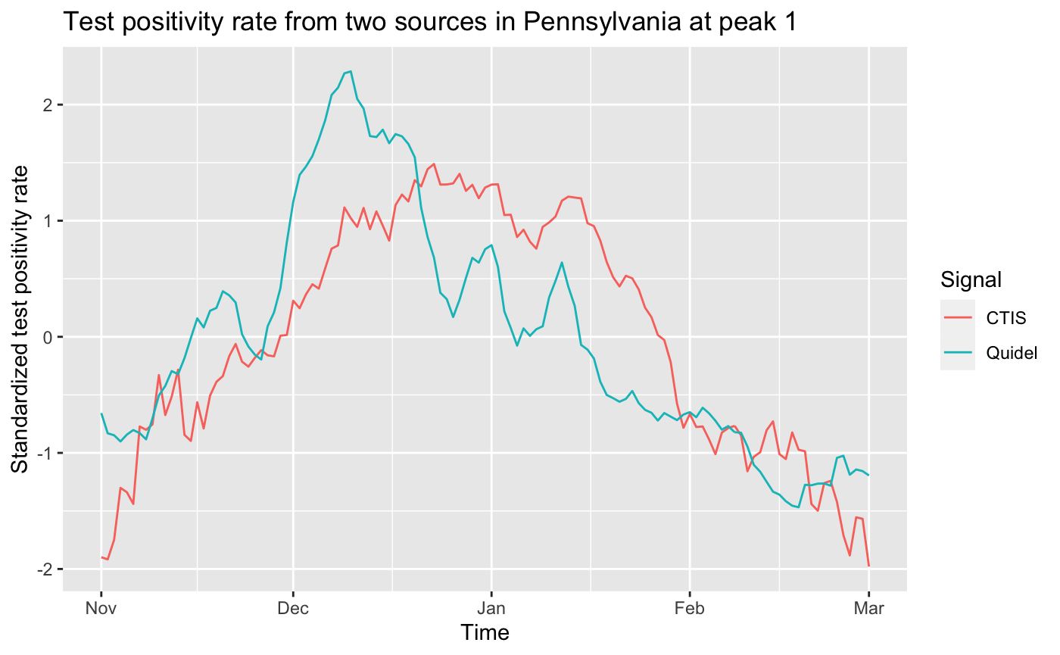
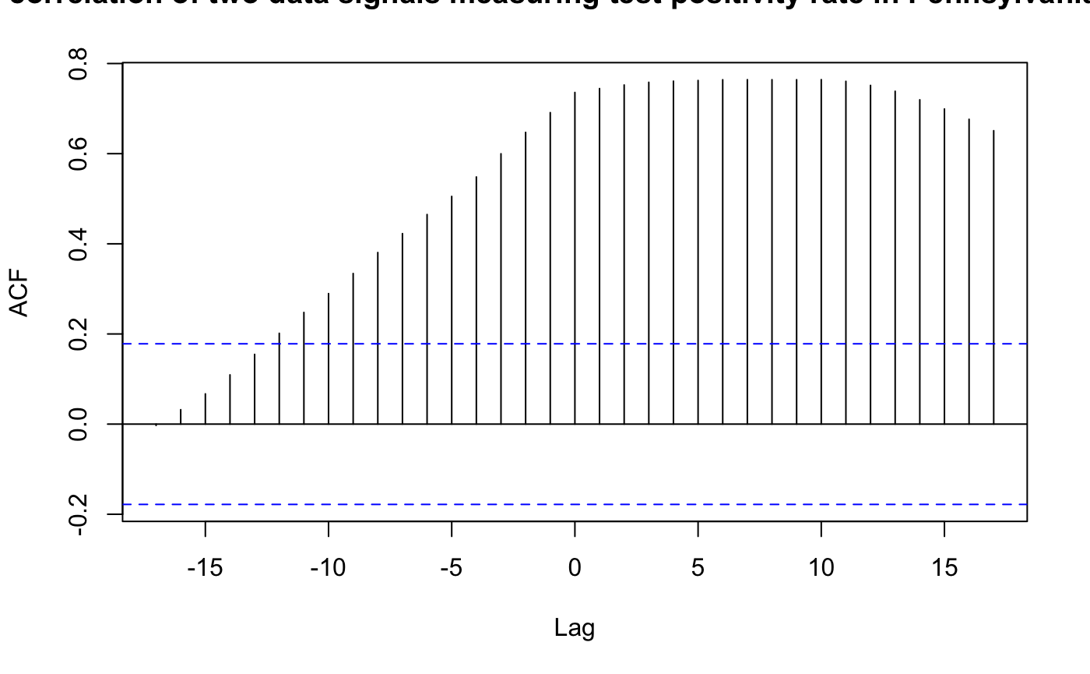
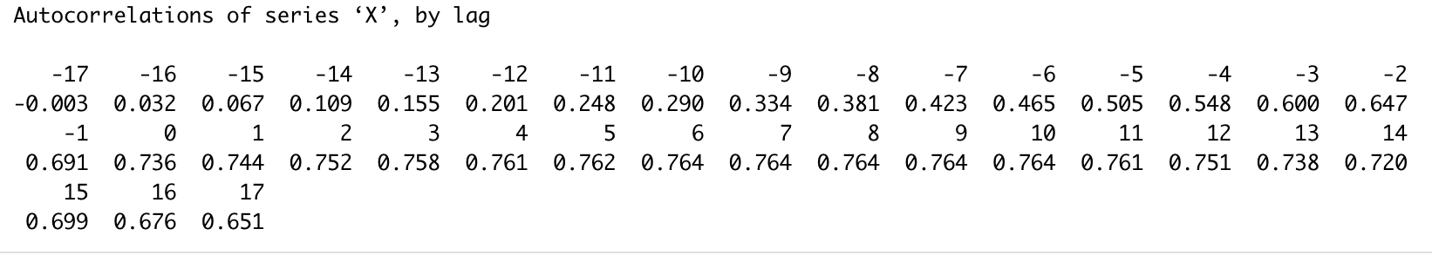
Test Positivity Rate - Peak 1
Notes:
Rank cor: 0.8030551

Slide 17
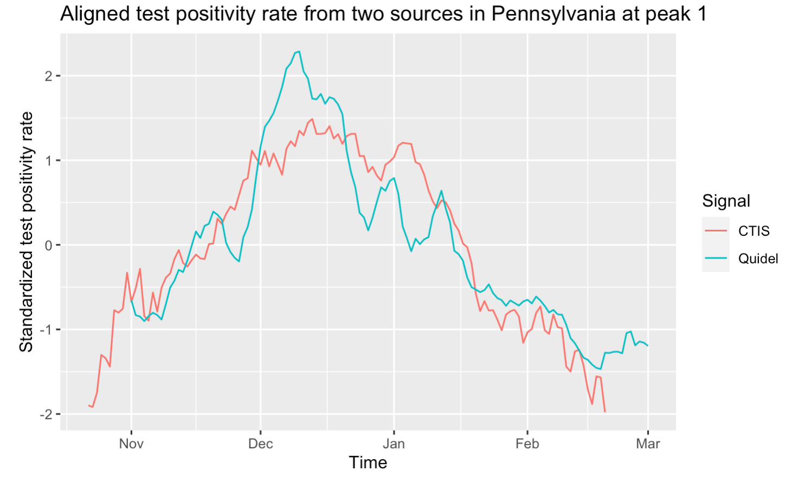
Test Positivity Rate - Peak 1
Aligned series based on highest CCF: lag 10
Notes:
Question: how we actually segment the time?

Slide 18
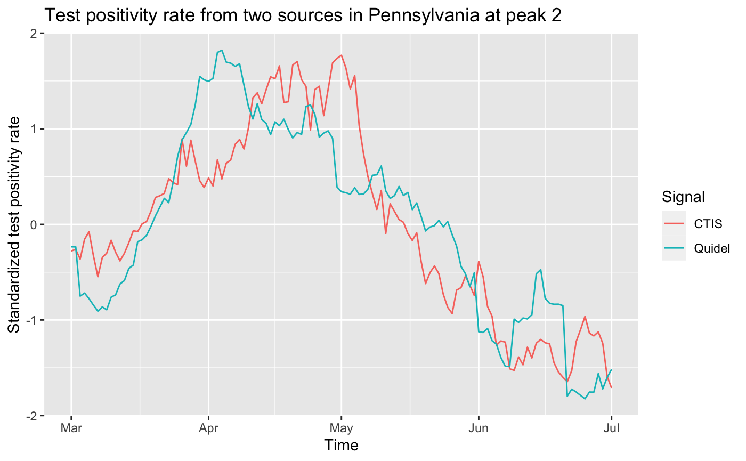
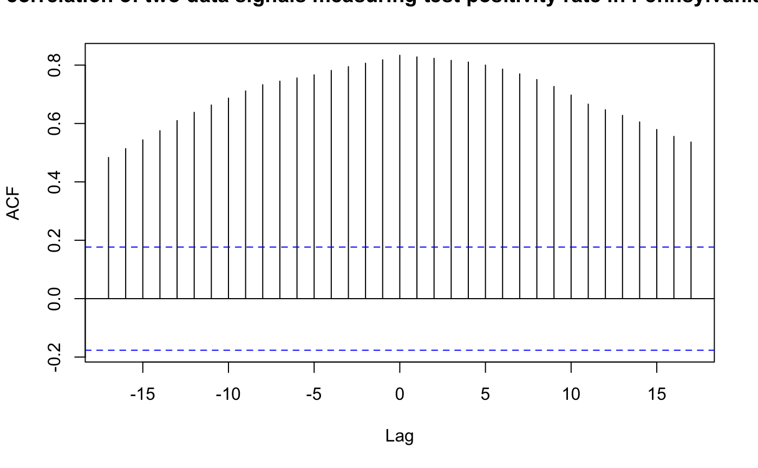
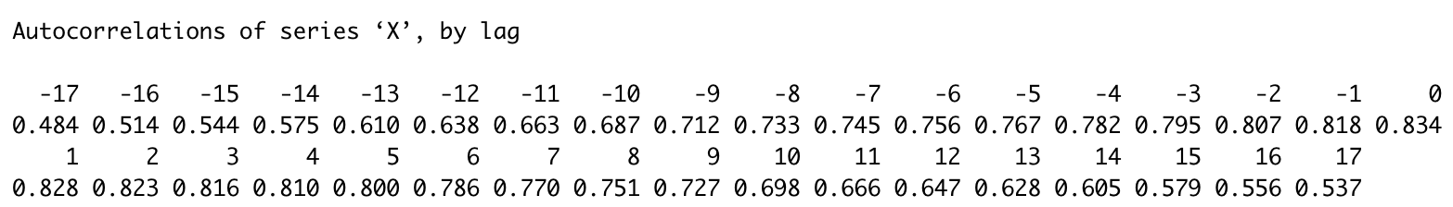
Test Positivity Rate - Peak 2
Notes:
Rank cor: 0.8565026

Slide 19
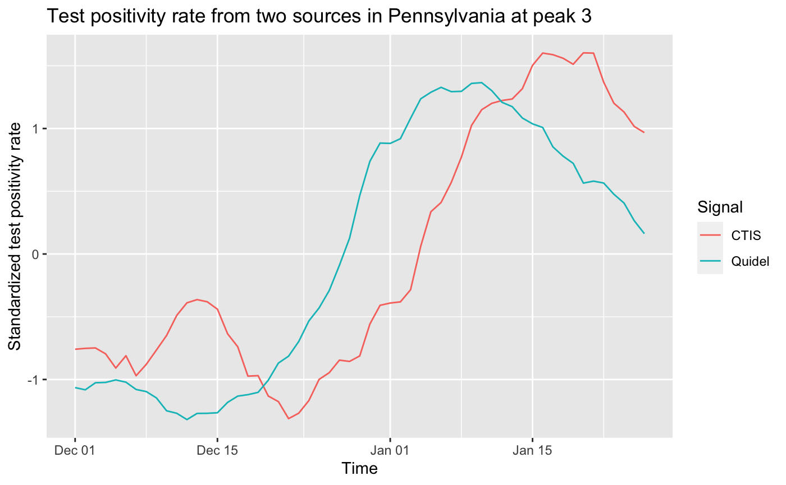
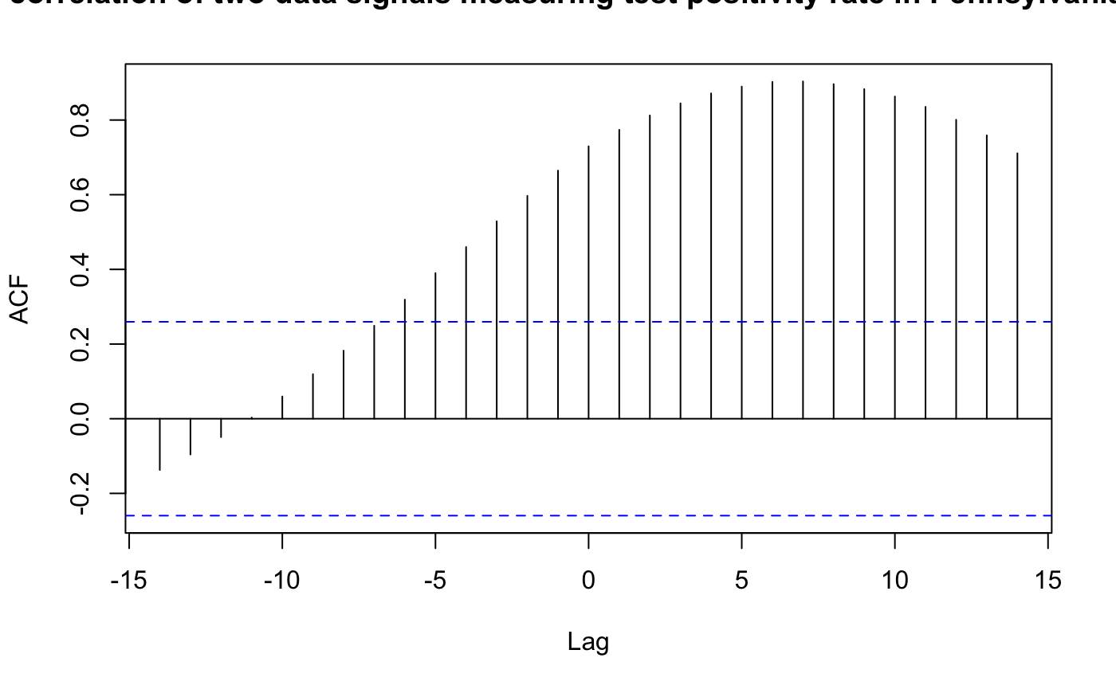
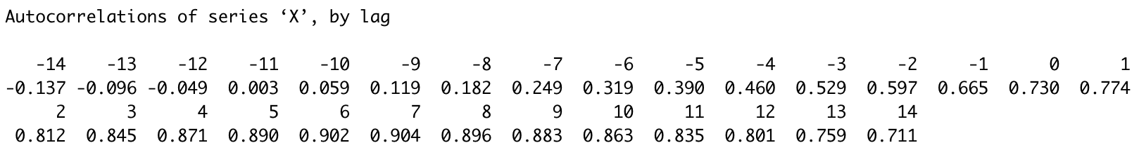
Test Positivity Rate - Peak 3
Notes:
Rank cor: 0.5894478

Slide 20
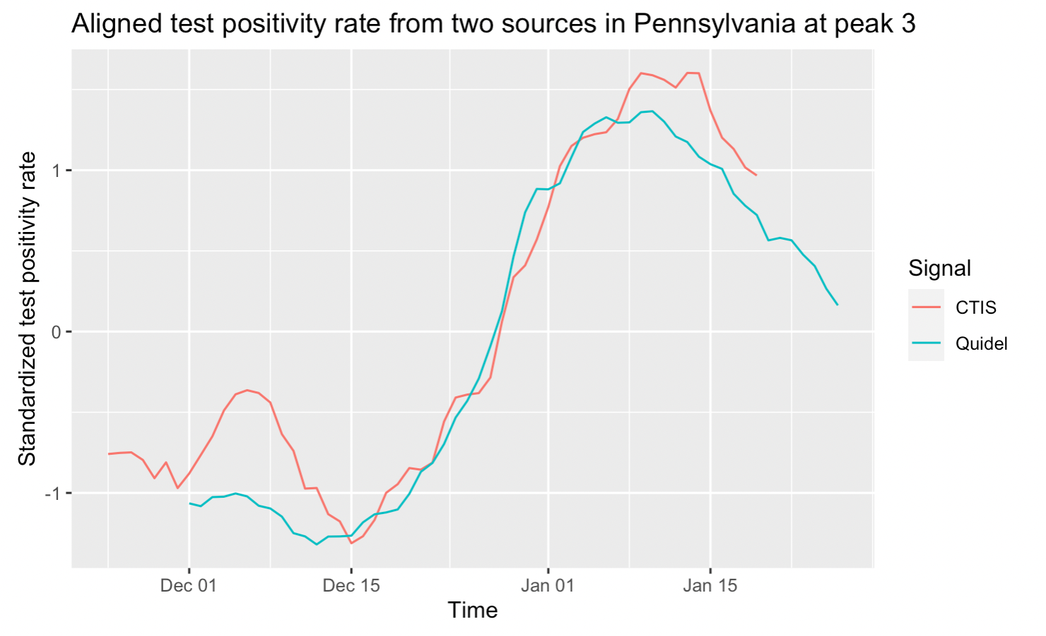
Test Positivity Rate - Peak 3
Aligned series based on highest CCF: lag 7

Slide 21
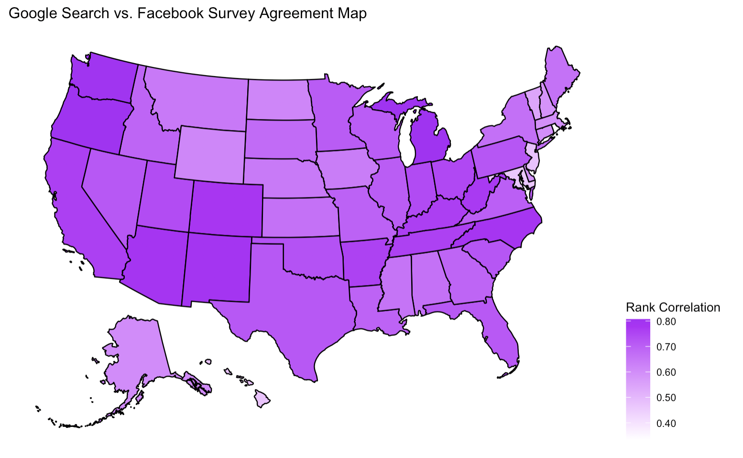
Google Search vs. Facebook Survey Across Country
Less agreement in New England/Midwest
More agreement in West/Central

Slide 22
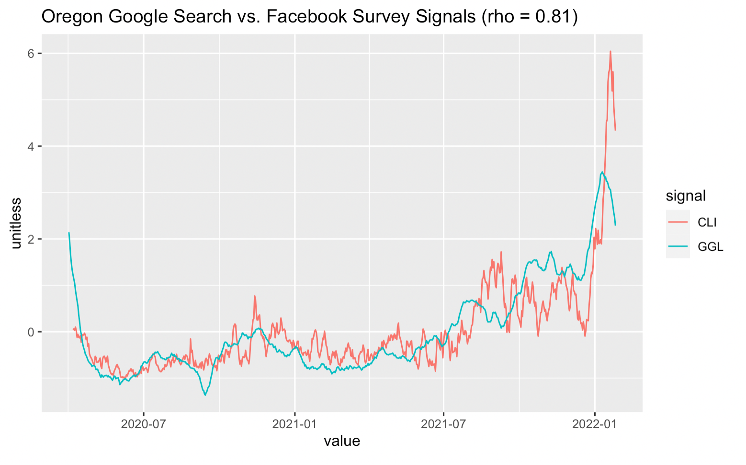
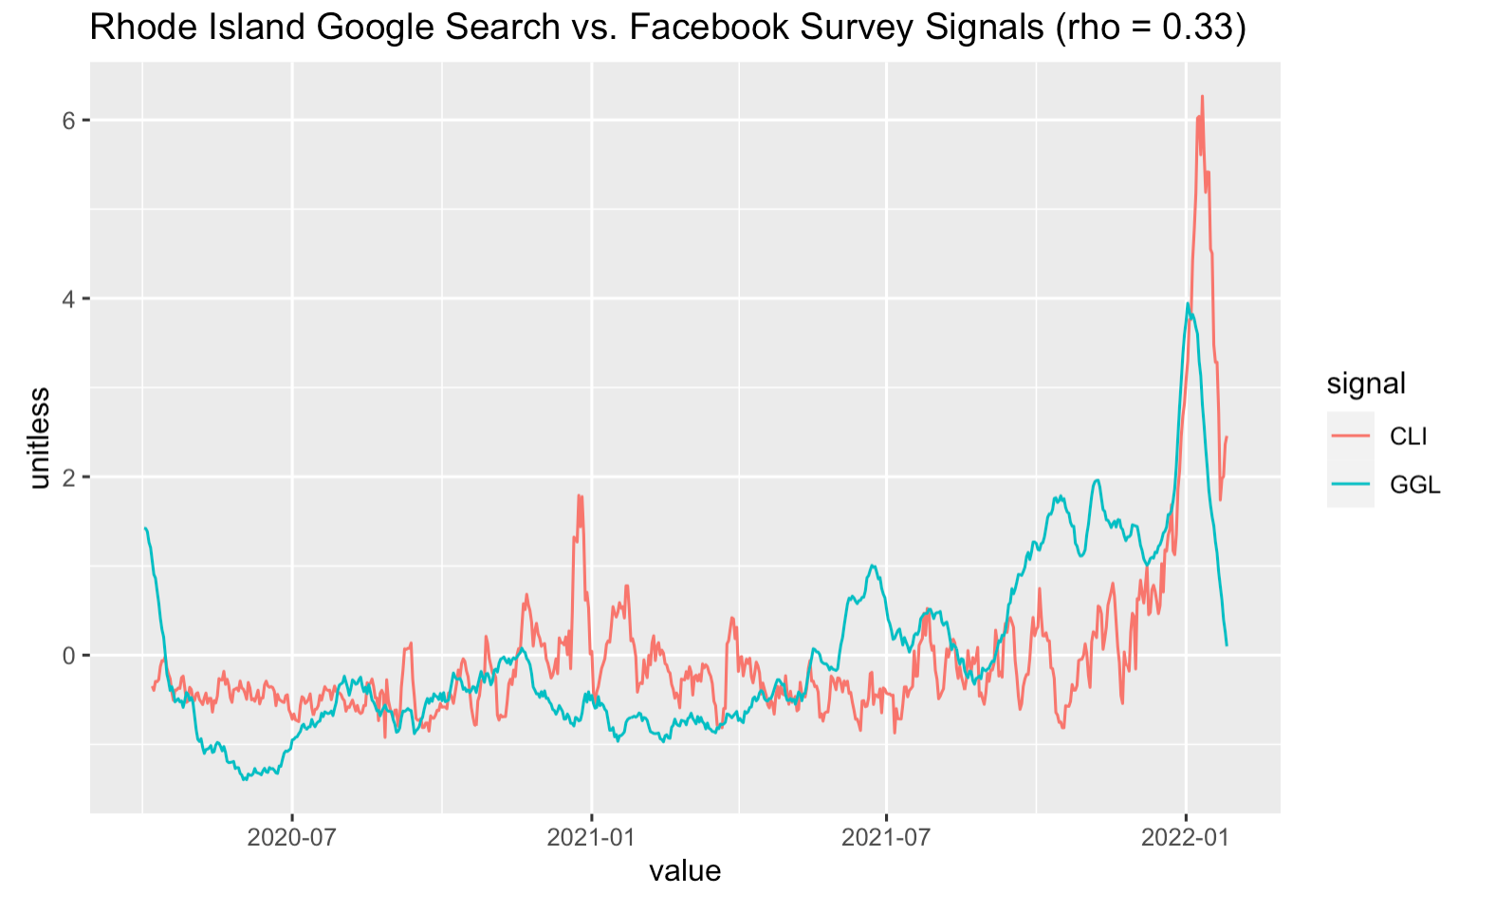
Google Search vs. Facebook Survey Across States
Most Agreement:
Least Agreement:

Slide 23
Possible Reasons for Disagreements:
Policy change: Democratic party has conducted several policy change from 2021 to 2022
Missing data: Much data in Test positivity rate from CTIS and Quidel is missing
Biasness - For small sample sizes, the response might be affected
Future investigation: we should use more approach to evaluate the correlation and similarities

